Slide 1

BIL 10-29 Frac Hit Summary
Apr 2025

Slide 2
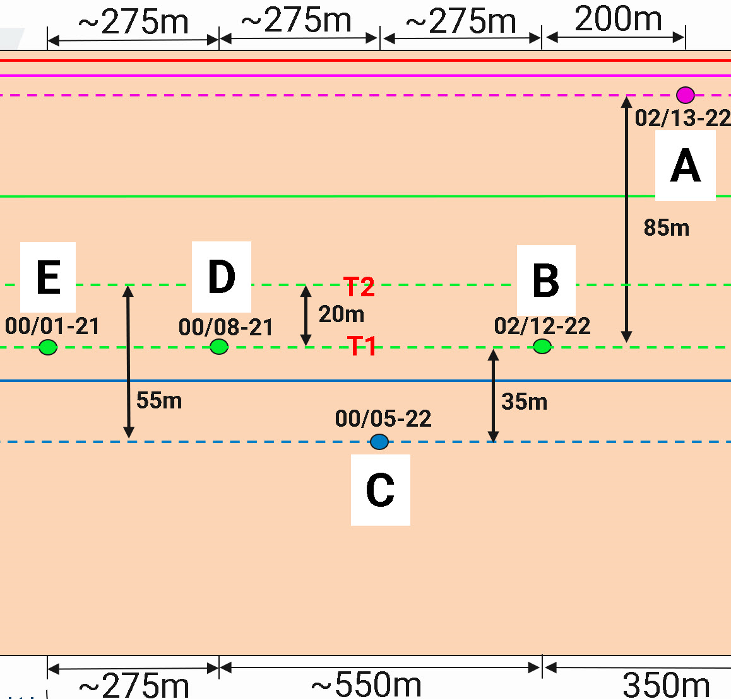
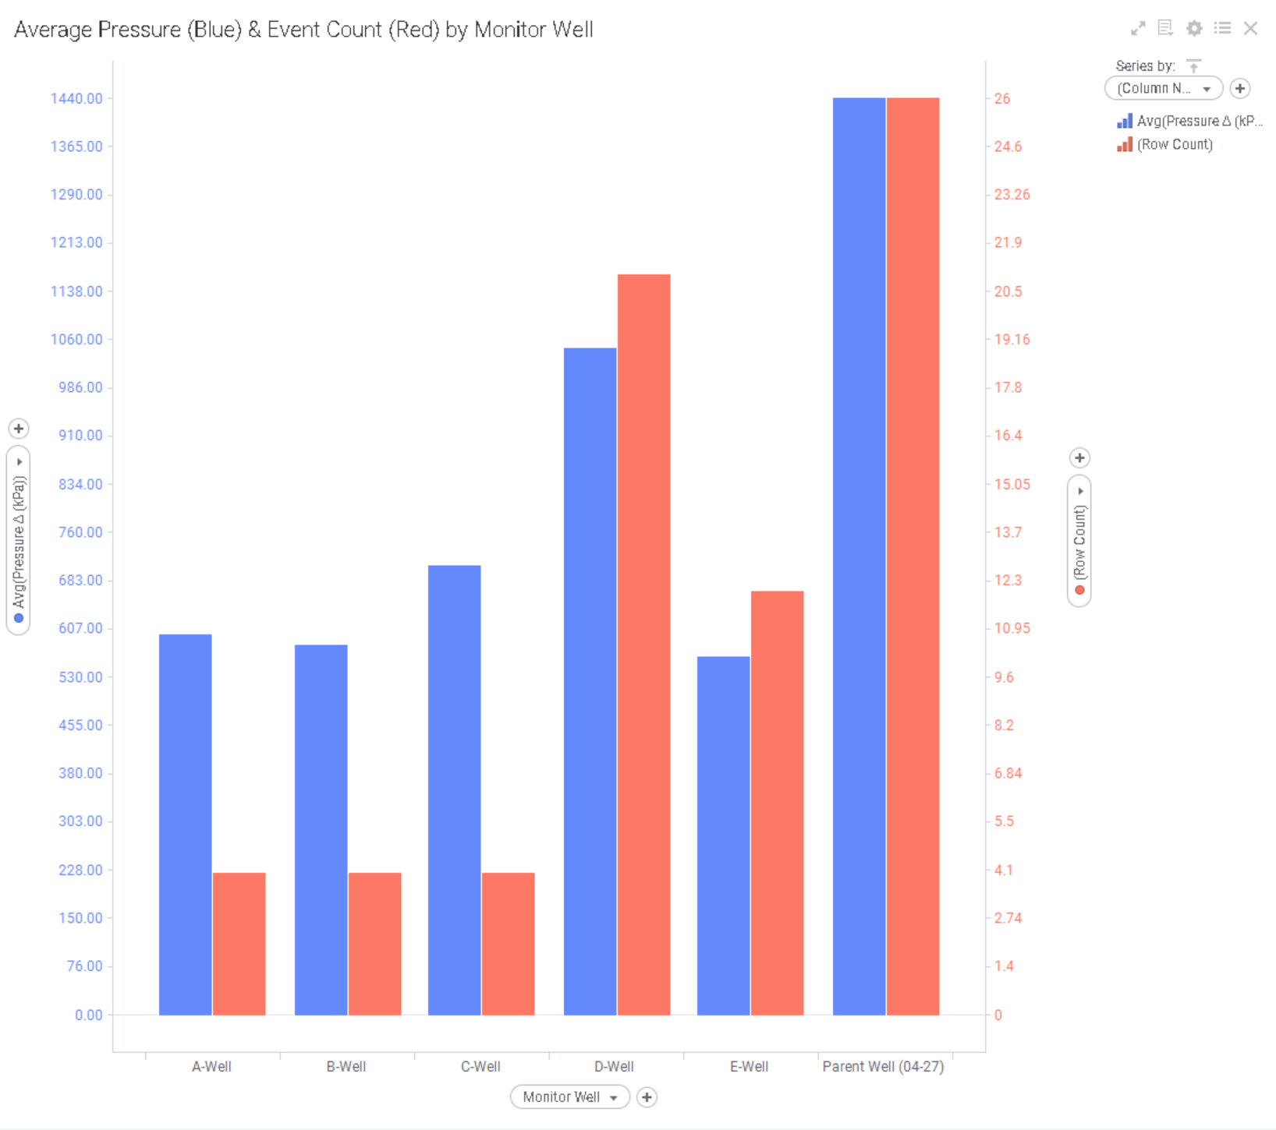
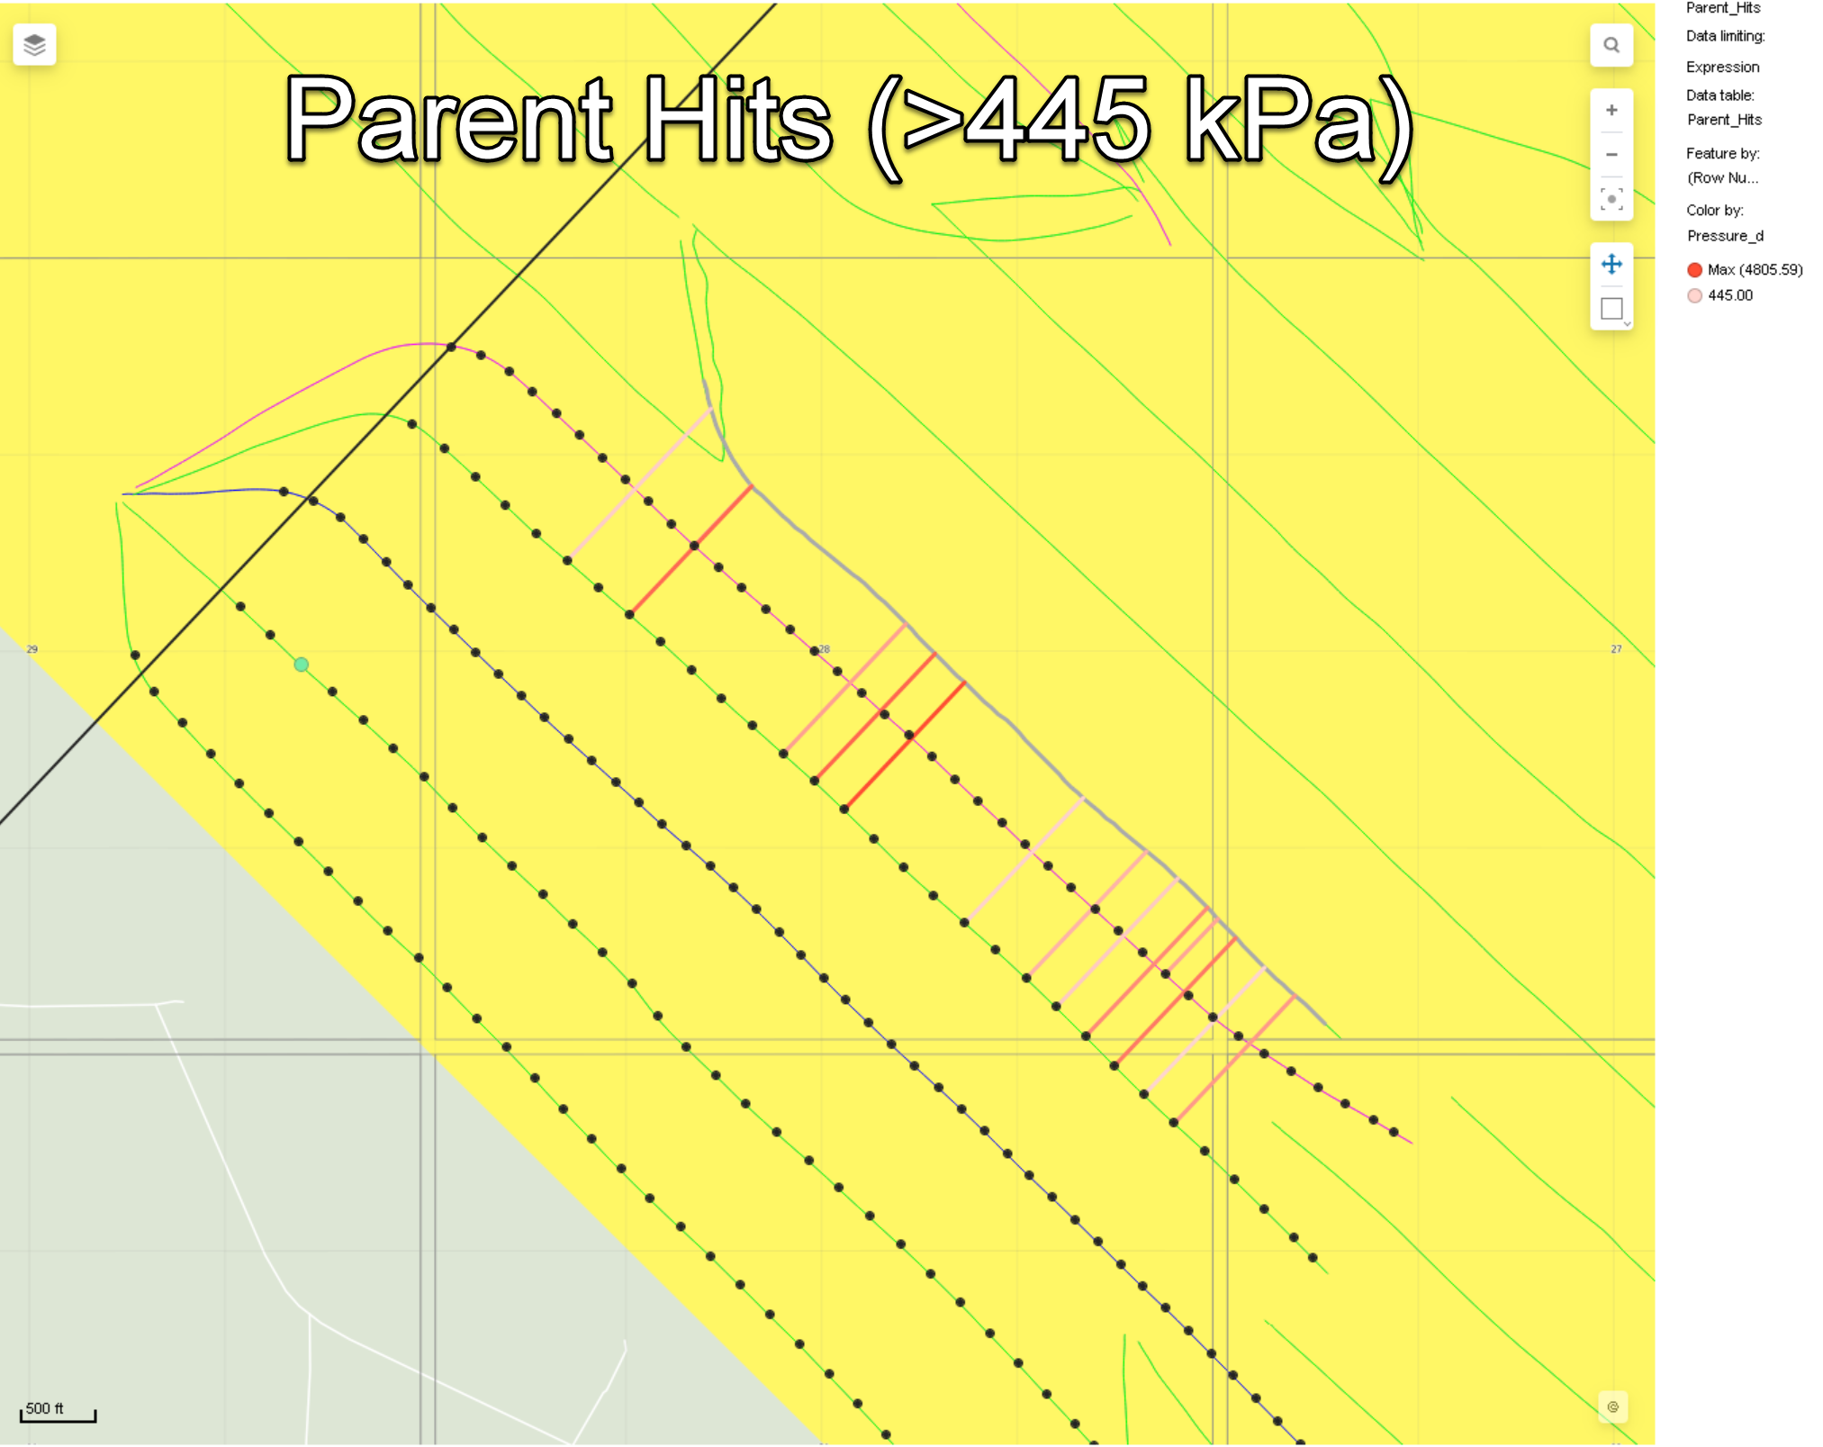
Overview
BIL 10-29 Frac Hits
Except for the parent well (04-27), all significant frac hits (over 445 kPa) originated from nearby wells as expected. 100% of sizeable hits were from immediate neighbors, with no unexpected or anomalous activity observed.
Parent Well (04-27) was the most hit. Majority of the pressure communication on BIL 10-29 occurred from the B-Well to Parent Well 04-27, with both the B-Well and Parent Well being in the MNTN B.
The D-Well was hit significantly more than all other wells on BIL 10-29.

Slide 3
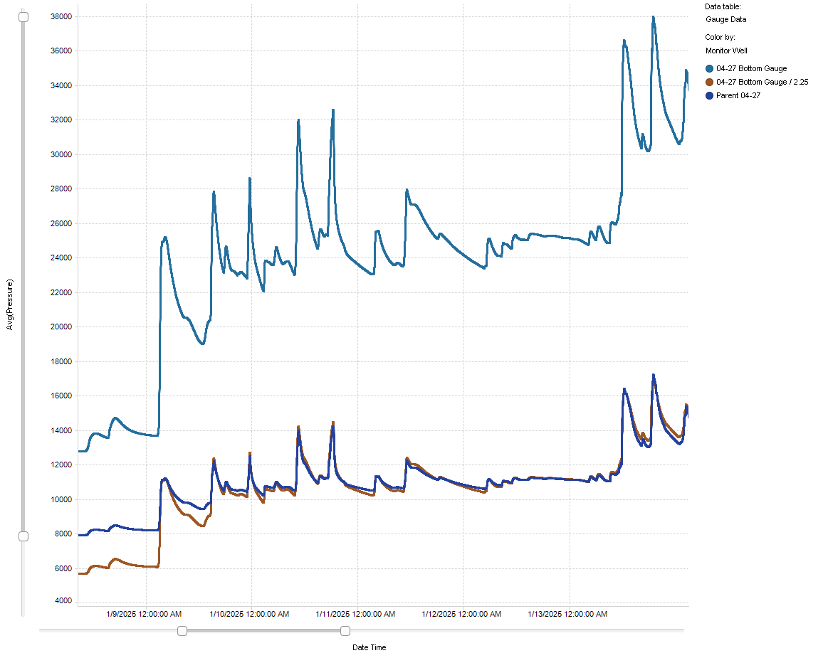
Downhole Gauge Data Approximation
BIL 10-29 Frac Hits
The downhole gauge data from the parent well demonstrates a direct correlation with the surface gauge readings but consistently indicates higher pressure magnitudes. By dividing the downhole gauge values by 2.25 (represented by the brown line), we obtain a reasonable approximation of the surface gauge response.
To help clarify data trends and identify significant events, an arbitrary threshold of 445 kPa surface pressure (approximately 1000 kPa downhole) has been selected to define large or notable frac hits.

Slide 4
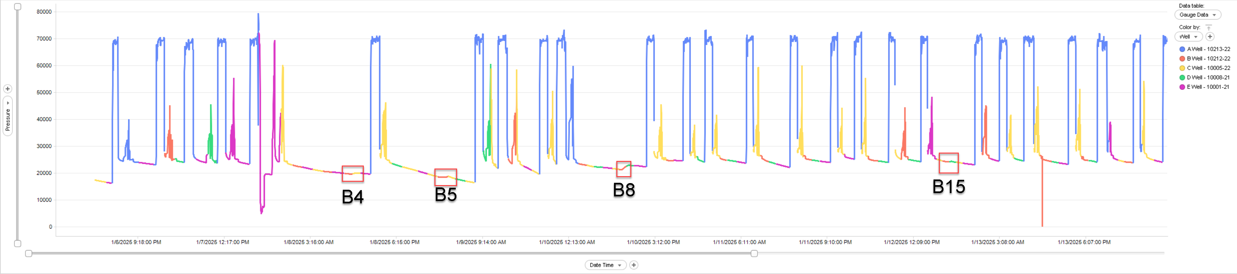
A-Well (02/13-22) – MNTN C
Fracking Well | Stage | Pressure Δ (kPa)
B-Well | B4 | 291.46
B-Well | B5 | 357.02
B-Well | B8 | 1598.63
B-Well | B15 | 140.01
Conclusion: A-Well (MNTN C) only hit and communicated with by B-Well (MNTN B).

Slide 5
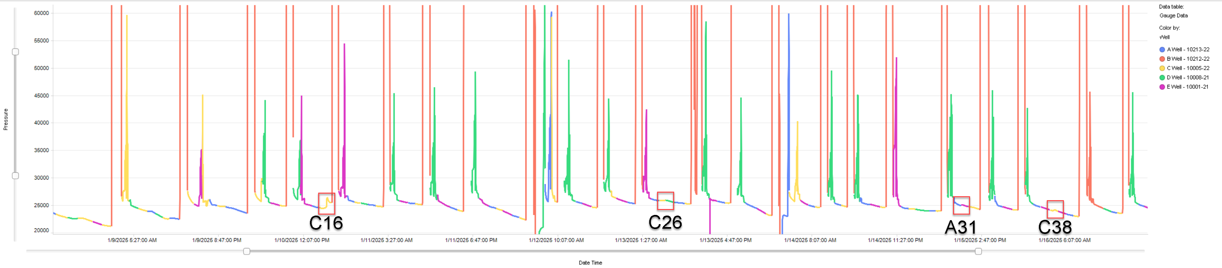
B-Well (02/12-22) – MNTN B
Fracking Well | Stage | Pressure Δ (kPa)
C-Well | C16 | 1981.04
C-Well | C26 | 114.91
A-Well | A31 | 124.73
C-Well | C38 | 105.99
Conclusion: B-Well (MNTN B) hit primarily by C-Well (MNTN A), with additional communication from A-Well (MNTN C)

Slide 6
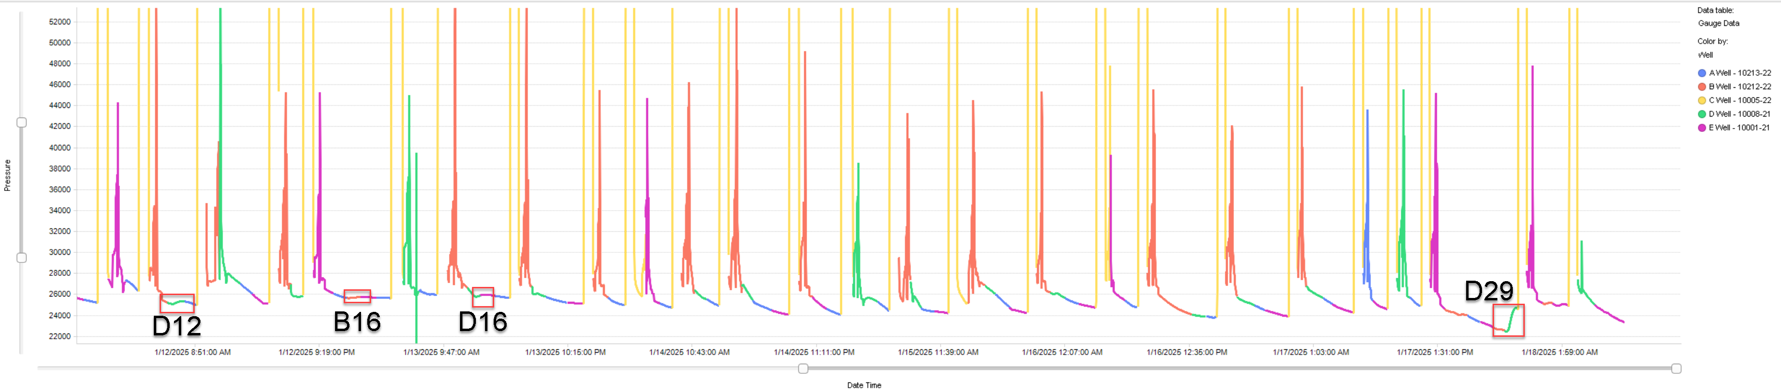
C-Well (00/15-22) – MNTN A
Fracking Well | Stage | Pressure Δ (kPa)
D-Well | D12 | 266.65
B-Well | B16 | 134.67
D-Well | D16 | 171.38
D-Well | D29 | 2251.11
Conclusion: C-Well (MNTN A) hit primarily by D-Well (MNTN B), with additional communication from B-Well (MNTN B)

Slide 7
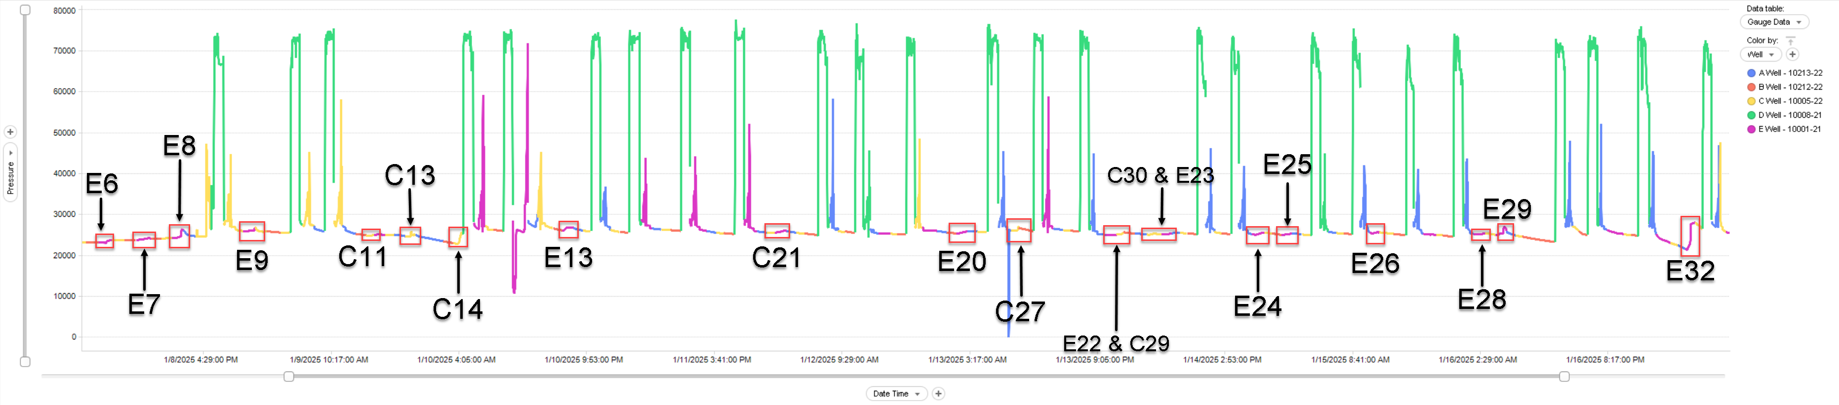
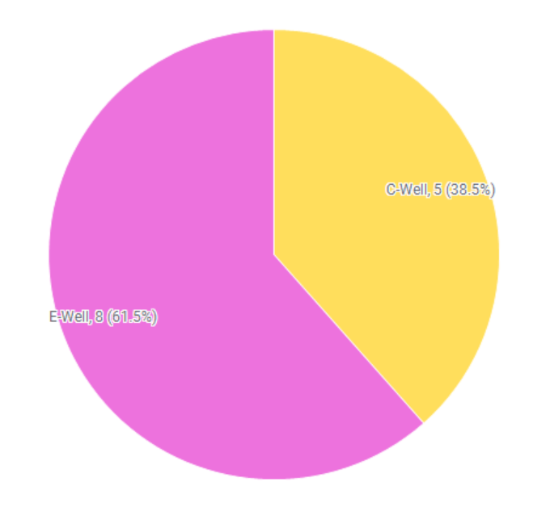
D-Well (00/08-21) – MNTN B
Fracking Well | Stage | Pressure Δ (kPa)
E-Well | E6 | 674.28
E-Well | E7 | 416.71
E-Well | E8 | 2089.34
E-Well | E9 | 935.18
C-Well | C11 | 255.82
C-Well | C13 | 1199.63
C-Well | C14 | 2566.05
E-Well | E13 | 686.81
C-Well | C21 | 551.98
E-Well | E20 | 562.93
C-Well | C27 | 937.61
E-Well | E22 | 163.63
C-Well | C29 | 559.88
C-Well | C30 | 204.49
E-Well | E23 | 330.43
E-Well | E24 | 454.88
E-Well | E25 | 395.48
E-Well | E26 | 262.00
E-Well | E28 | 200.99
E-Well | E29 | 1962.09
E-Well | E32 | 6583.78
Conclusion: Both E-Well (MNTN B) and C-Well (MNTN A) showed consistent and relatively high magnitude communication with D-Well (MNTN B)
Large Frac Hit Distribution

Slide 8
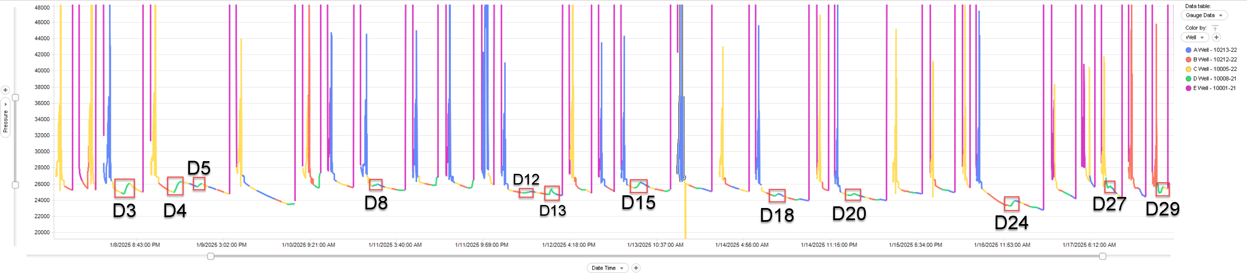
E-Well (00/01-21) – MNTN B
Fracking Well | Stage | Pressure Δ (kPa)
D-Well | D3 | 1213.97
D-Well | D4 | 1332.07
D-Well | D5 | 346.60
D-Well | D8 | 199.73
D-Well | D12 | 136.517
D-Well | D13 | 817.98
D-Well | D15 | 635.54
D-Well | D18 | 230.81
D-Well | D20 | 174.62
D-Well | D24 | 674.51
D-Well | D27 | 222.75
D-Well | D29 | 766.90
Conclusion: The D-Well (MNTN B) showed consistent hits to the E-Well (MNTN B). Communication occurred almost every stage.

Slide 9
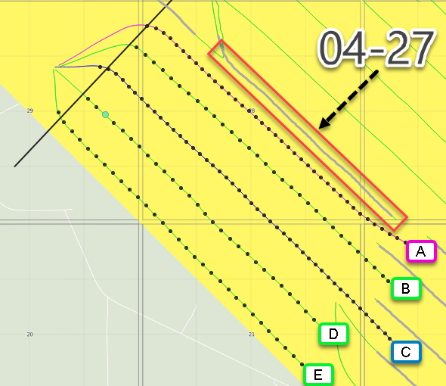
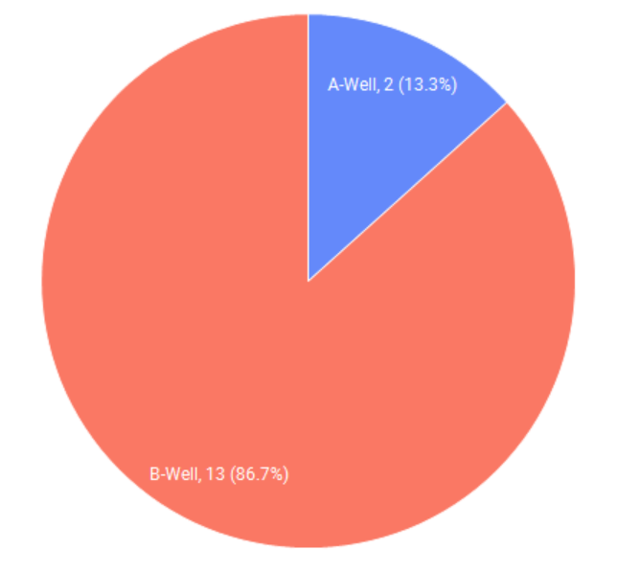
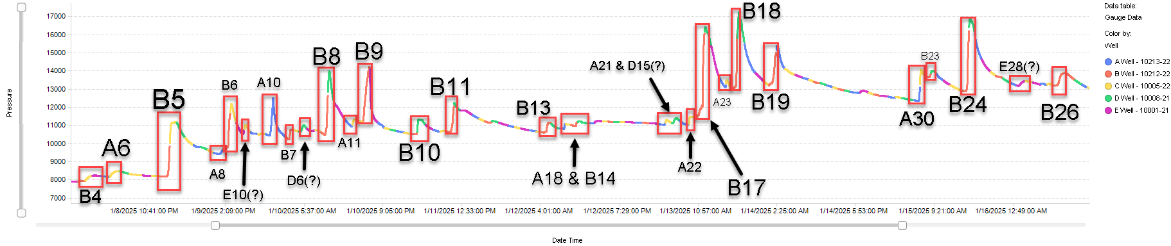
Parent Well 04-27 – MNTN B
Large Frac Hit Distribution
Fracking Well | Stage | Pressure Δ (kPa)
B-Well | B4 | 304.326
A-Well | A6 | 315.87
B-Well | B5 | 2929.47
A-Well | A8 | 221
B-Well | B6 | 2390.88
E-Well | E10 | 302.98
A-Well | A10 | 1982.38
B-Well | B7 | 453.79
Complicated* | D6/ C14 | 324.02
B-Well | B8 | 3416.85
A-Well | A11 | 333.97
B-Well | B9 | 2887.17
B-Well | B10 | 794.92
B-Well | B11 | 1544.31
B-Well | B13 | 525.91
A-Well | A18 | 226.60
B-Well | B14 | 242.66
A-Well | A21 | 252.25
D-Well | D15 | 267.42
A-Well | A22 | 405.57
B-Well | B17 | 4805.59
Fracking Well | Stage | Pressure Δ (kPa)
A-Well | A23 | 354.83
B-Well | B18 | 4033.24
B-Well | B19 | 2164.24
A-Well | A30 | 1704.745
B-Well | B24 | 3925.94
Complicated* | E28/A23 | 239.58
B-Well | B26 | 679.19
Conclusion: A-Well and B-Well continuously communicated to Parent Well 04-27, with many hits occurring at the end of the stage. B-Well made up almost the entirety of sizeable frac hits.

Slide 10
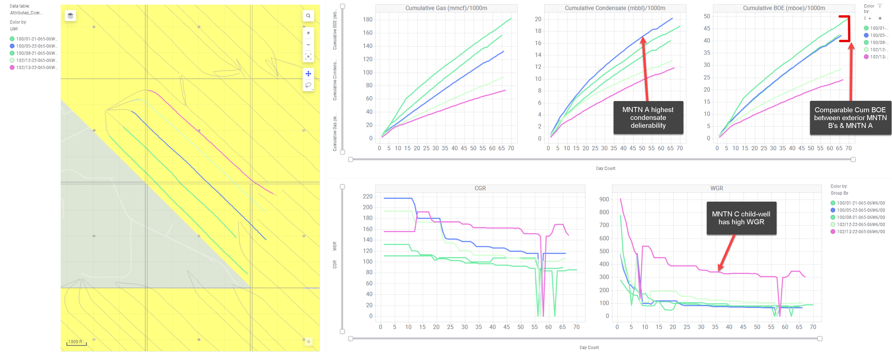
10-29 Well Results

Slide 11
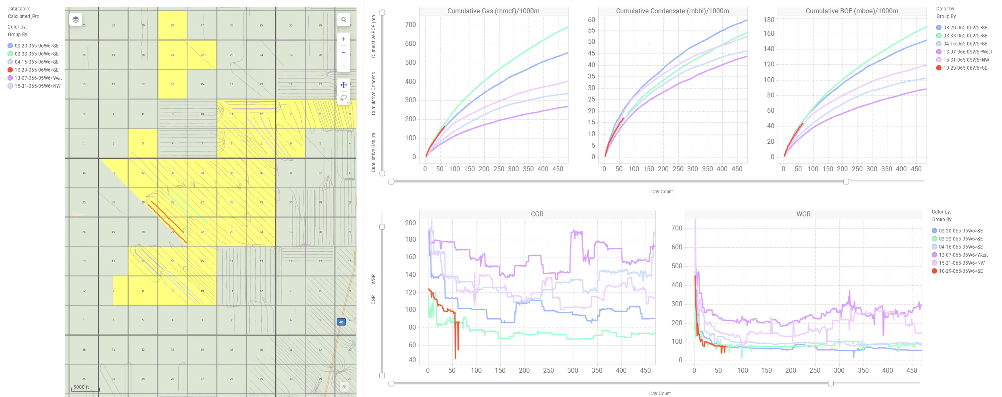
MNTN B Broad Comparison
Pad is on high-side of past results
Water resembling southern Bilbo development

Slide 12
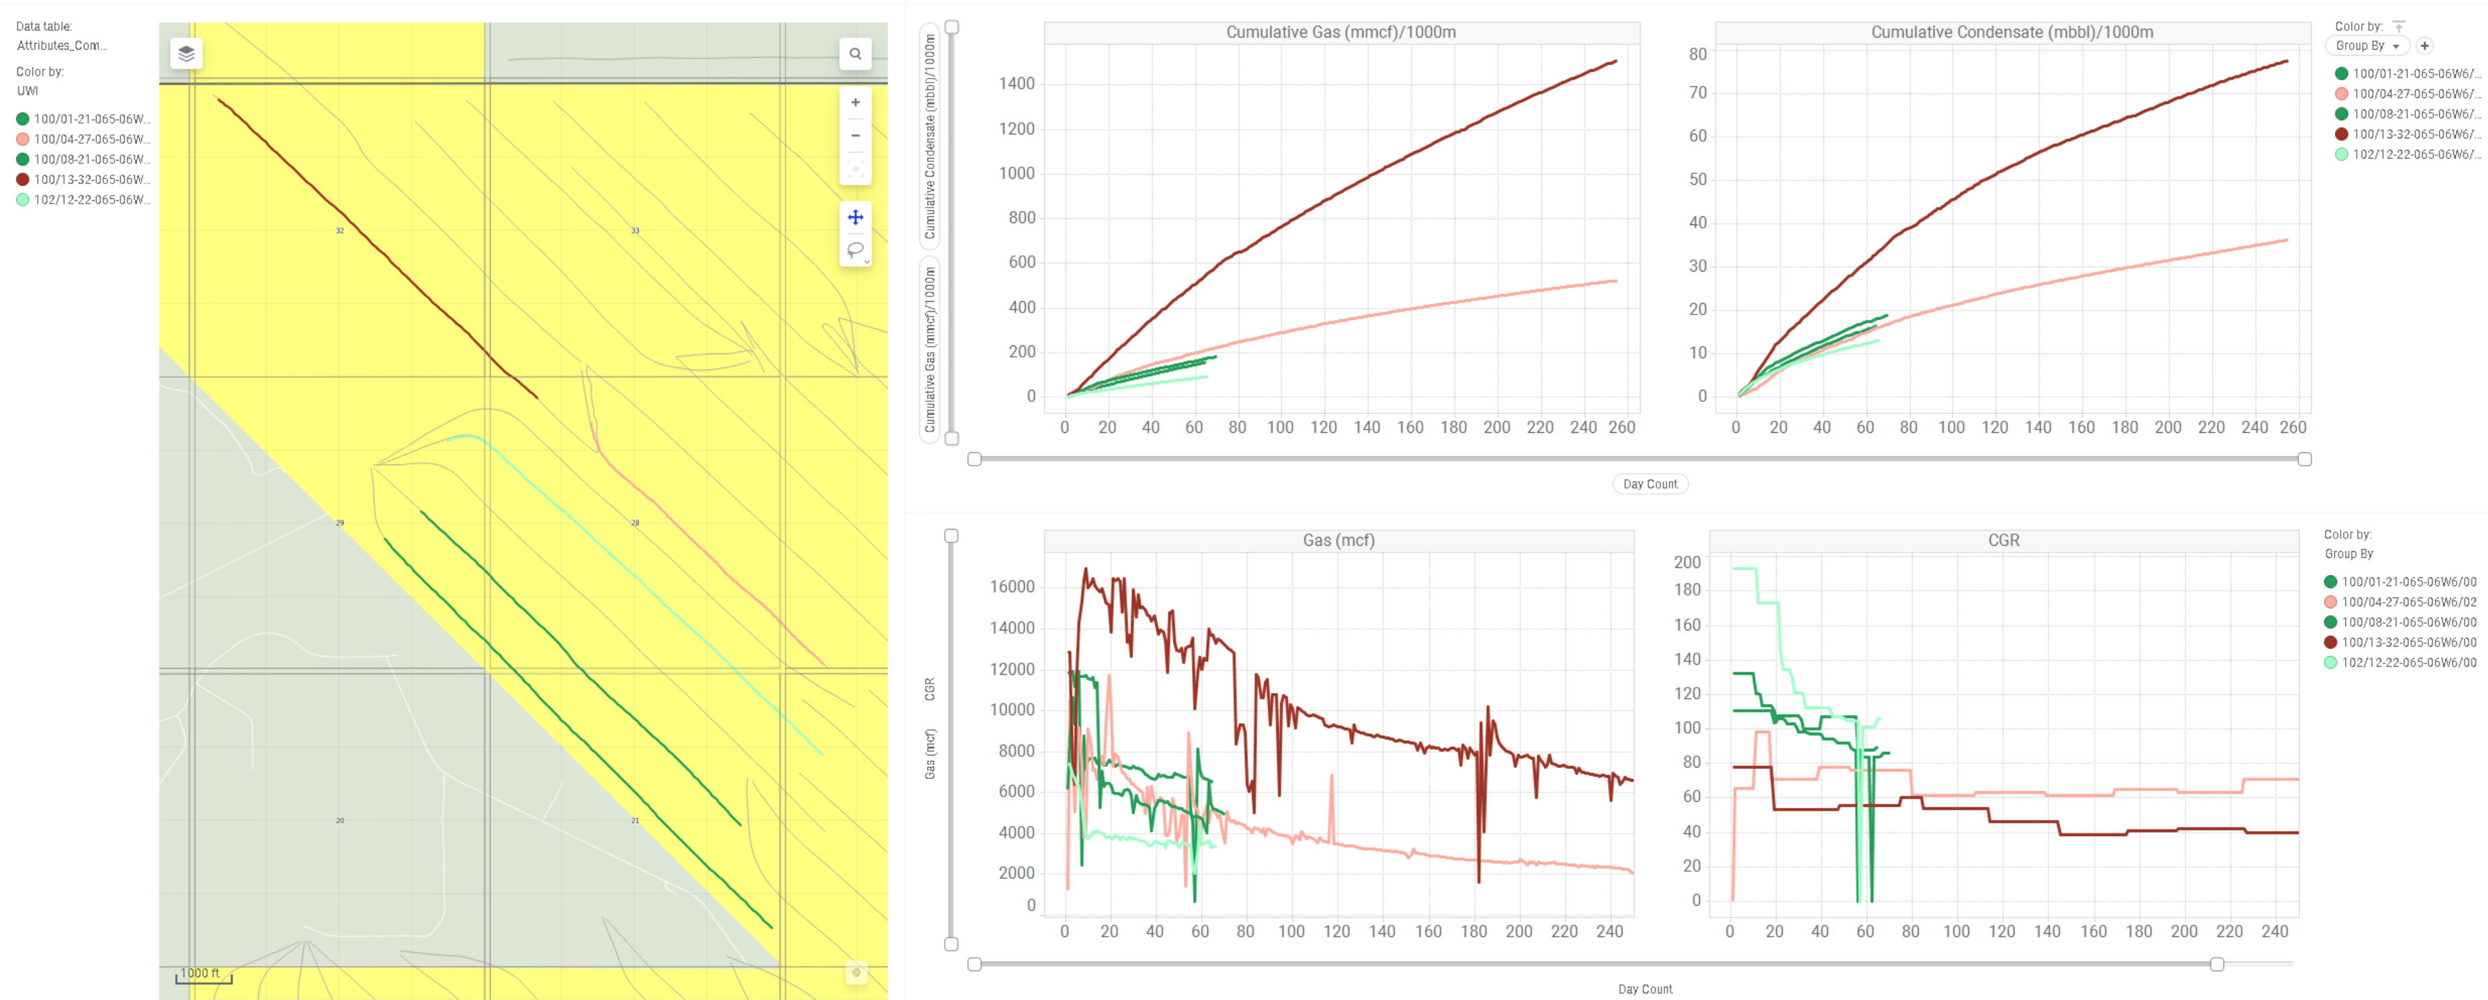
MNTN B Immediate Comparison
100/13-22 well onstream gas rate at 16,000mcf. New wells flowed up tubing limiting gas rate capability.

Slide 13
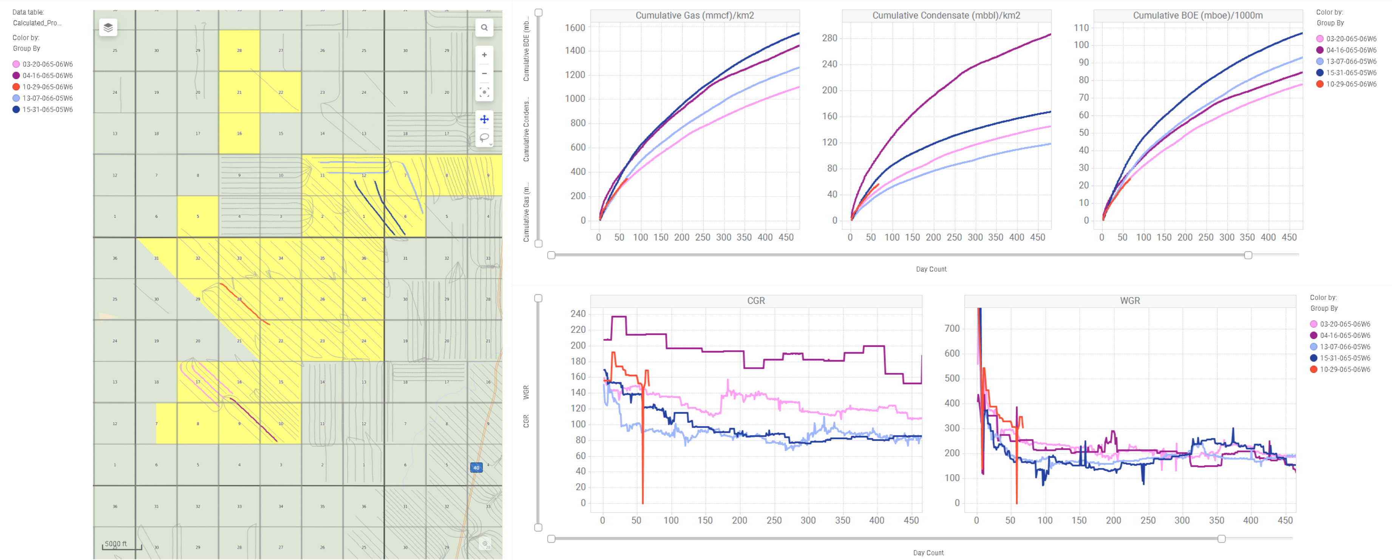
MNTN C Comparison
Infill test production roughly inline with offsets – minimal depletion impact.

Slide 14
Additional Noted Information
Stages with hits <100kPa or caused change in decline slope
A-Well Monitoring: B22, B24, B25, B28 and B31
B-Well Monitoring: D3, A7, C10, A14, A16, C34, C38, C42 and C43
C-Well Monitoring : B24, B29 and D23
D-Well Monitoring : C4, C7, C23, E18, E19, E27, E30, E33 and E35
E-Well Monitoring : D6, D11, D14, D16, D19, D21, D22, D23, D25 and D27

